Slide 1

Controlling Player Avatars in Game Worlds Using Multi-Modal Input Systems
Final Year Project: Progress Presentation
( Portfolio Project )
By:
Charlie Lloyd-Buckingham
( s5109920 )
Notes:
(00:00) - > (00:30)
My project is about building a system that will allow for the combined acquisition and analysis of real-time data from EEG, EMG and eye-tracking devices.
Using said system, behaviours and interactions within a games world will be explored, with the creation of two example demo’s being created along side, demonstrating the usage though the control of an avatar skeletal rig and the scaling of game difficulty.

Slide 2

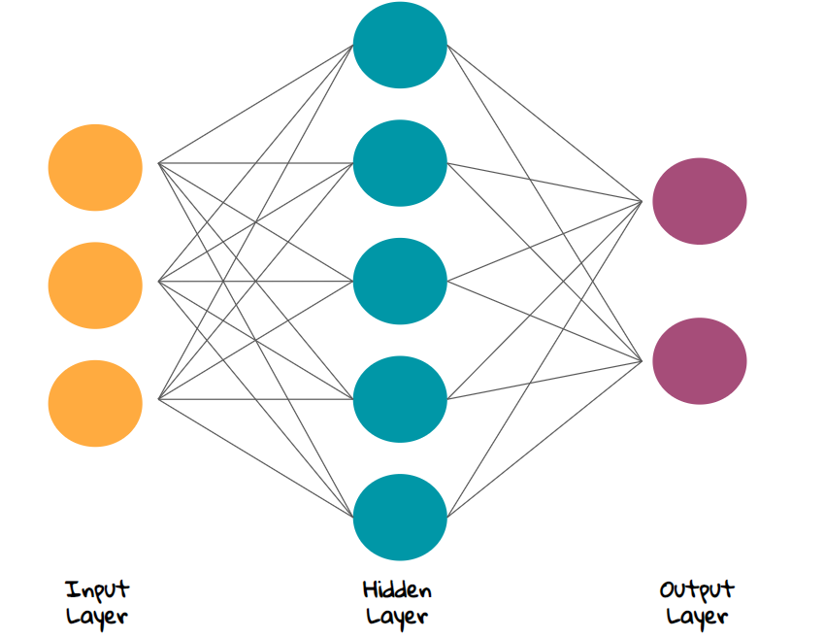

My Project:
EEG Input
EMG Input
Eye Tracking Input
To build a multi-modal input system / pipeline for supporting EEG, EMG and eye-tracking.
Data:
EEG data -EEGO amplifier
EMG data – emteqPro
Eye tracking from HTC Vive Pro
Data streams will be fed as inputs for a neural network for processing.
Output will be used for two game inputs
( Mood -> Difficulty ) calculator for simple game.
Avatar rig controller
Notes:
(00:30) - > (01:30)
My project is about building a system that will allow for the combined acquisition and analysis of real-time data streamed from EEG, EMG and eye-tracking devices.
Using this system, interactions within a games world will be explored:
Two example demo’s being created to demonstrate this systems effects, the control of an avatar skeletal rig and the scaling of game difficulty using mood or focus states.
This will be calculated by using neural network classification to define states using previously recorded and marked data.

Slide 3
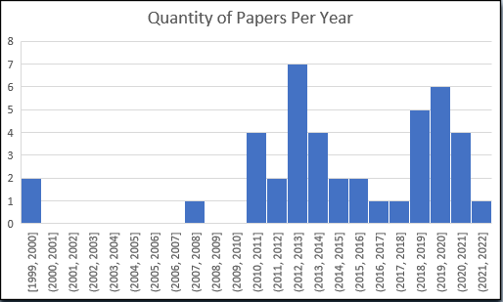
Literature Review:
From the Publishers:
Journals:
Journal of Games, Game Art, and Gamification
Journal of Neuro-Engineering and Rehabilitation
Serious Games & Simulation for Risks Management
Entertainment Computing
GeNeDis
Research in developmental disabilities
IEEE Robotics & Automation Magazine
IEEE Transactions on Computational Intelligence and AI in Games
IEEE Transactions on Neural Systems and Rehabilitation Engineering
IEEE
Springer
Elsevier
Frontiers
MDPI
AIP Publishing LLC
Papers Read: 35
Cited In Dissertation: 23
Conference Proceedings and Adjunct Publications:
International Conference on Serious Games and Applications for Health (SeGAH)
International Symposium on Consumer Electronics ( ISCE )
International Conference on Robotics and Biomimetics (ROBIO)
International Conference on Information Visualisation
Augmented Human International Conference
AIP Conference
International Conference on Fun and Games
Conference on User Modelling, Adaptation and Personalization
Notes:
(01:30) - > (02:30)
To research this project I have read 35 papers, 23 of which I am currently siting in my dissertation.
A large proportion of these papers where published in 2019 to 2021, however there was a spike of useful work done around 2013.
The oldest paper I have cited was from 2008, which was a paper on using EMG to measure participant arousal (non-sexual) when different elements where added to a game. This was published in the Conference Proceedings of the International Conference on Fun and Games
Most of the papers where published by IEEE (The Institute of Electrical and Electronics Engineers), on top of this several where publish by Elsevier and Springer, while the remaining where published by the other publishers on the slide.

Slide 4
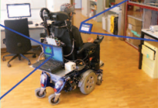
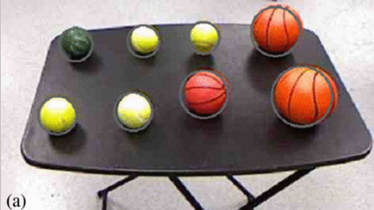
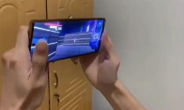
Literature Review:
( Carlson, 2013 )
( McMullen, 2013 )
( Haris, 2021 )
Topics:
- Using multi-modal input systems in games
- EEG in games
- EMG in games
- Multi-modal input systems using EEG
- Prosthetics
- Wheel chair controllers
- Multi-modal input systems using EMG
Notes:
(02:30) - > (03:30)
The targets of my research involved the usages of multi-modal input systems in games today, along side how EEG and EMG are used in both serious games and games for entertainment.
I was unable to find any studies directly relating to EEG and EMG used in multi-modal systems specially in the field of video games, however there was a large amount of papers involving the usages of multi-modal EEG and EMG system when used in prosthetics and wheel chair controllers.
Some notable papers I read about included:
- Carlson, 2013 - used a multi-modal system for controlling a wheel chair, this was accomplished by sampling EEG data from a 16 sensor system, and fed into a system with the results of a computer vision analysis. This then calculated pathing information to move around.
- McMullen, 2013 – used a multi-modal input system for controlling a prosthetic arm, computer vision, eye-tracking and EEG was used as inputs for the IK of a robot arm. This had a 100% succsess rate with singular objects, and a
- Haris, 2021 – The authors of the paper developed a multi-modal aiming system, basing there work off of the previous implementation in the mobile version of PUBG (Player Unknowns: Battle Ground). Where the gyroscope is used for aim assistance along side moving the camera through touch. Also mentions that players preferred this implementation.

Slide 5
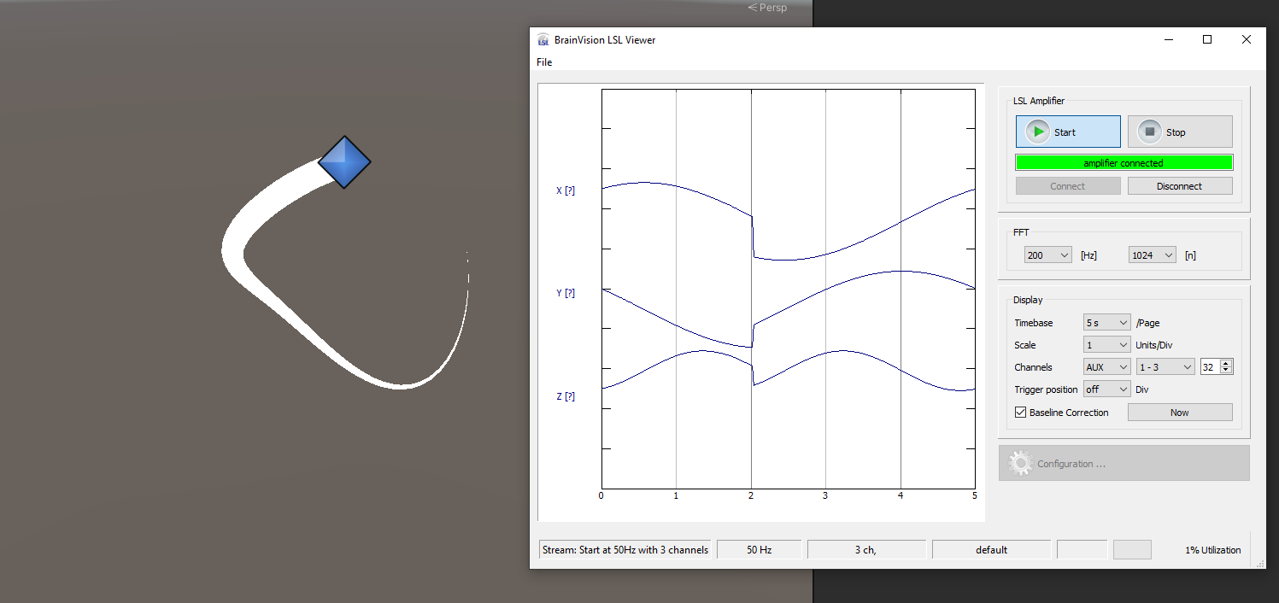
The Project Progress
EEG Input
EMG Input
Eye Tracking Input
Cross device communication has been completed using the LSL protocol
This can be used to send markers – in the case of needing to save data for offline ANN training.
For the collection of EEG, and EMG data.
Notes:
(03:30) - > (04:30)

Slide 6
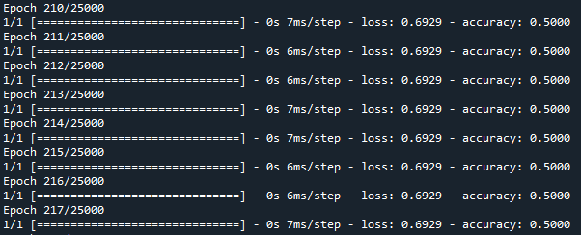
The Project Progress
EEG Input
EMG Input
Eye Tracking Input
Python code and environment setup for Tensorflow ANN models.
For trained XOR code
Notes:
(04:30) - > (05:30)

Slide 7
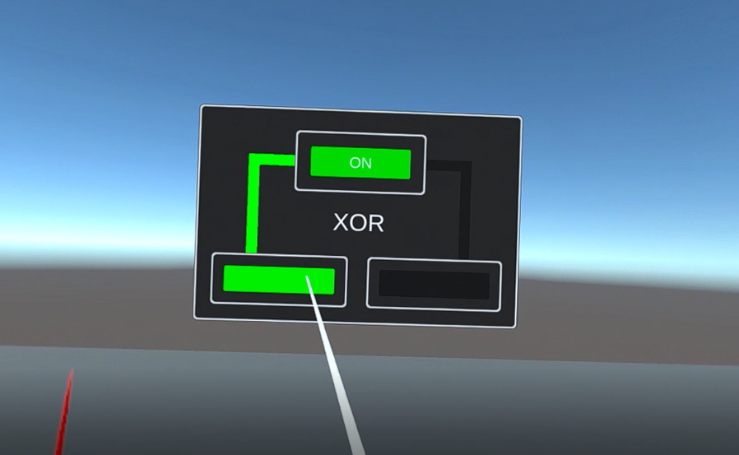
The Project Progress
EEG Input
EMG Input
Eye Tracking Input
VR has been setup in the project using the XR VR System
ANN Models usable in Unity
Setup Barracuda for ONNX files
Python conversion code for .h5 models to .onnx models complete
Testing ANN for XOR completed, working in Unity
Notes:
(05:30) - > (06:30)

Slide 8
The Project Progress
EEG Input
EMG Input
Eye Tracking Input
Notes:
(06:30) - > (07:30)

Slide 9
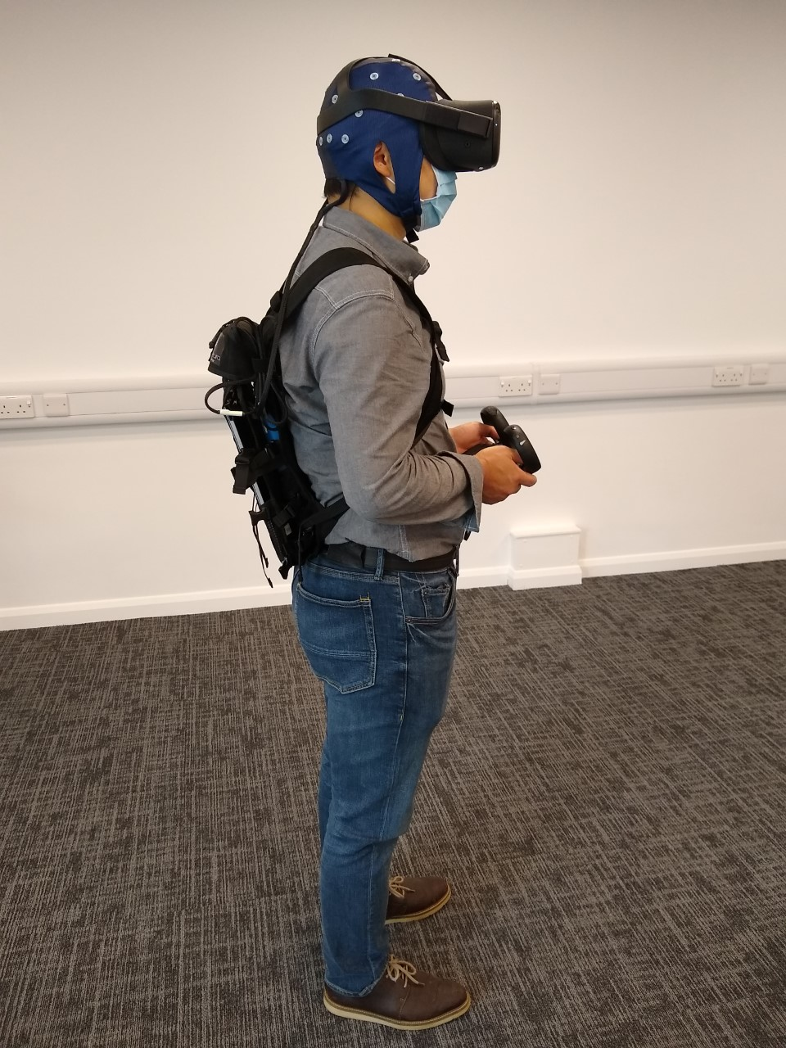
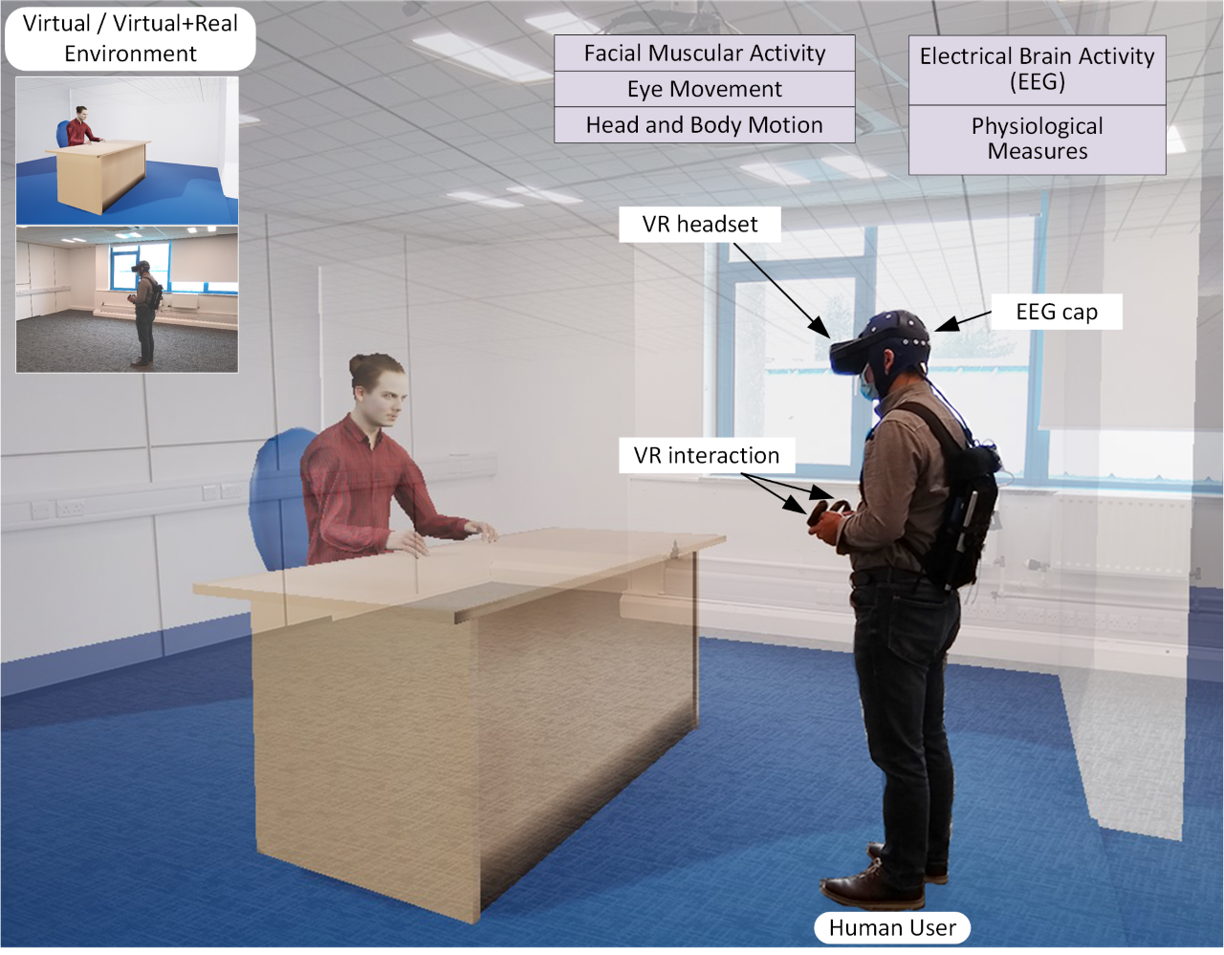
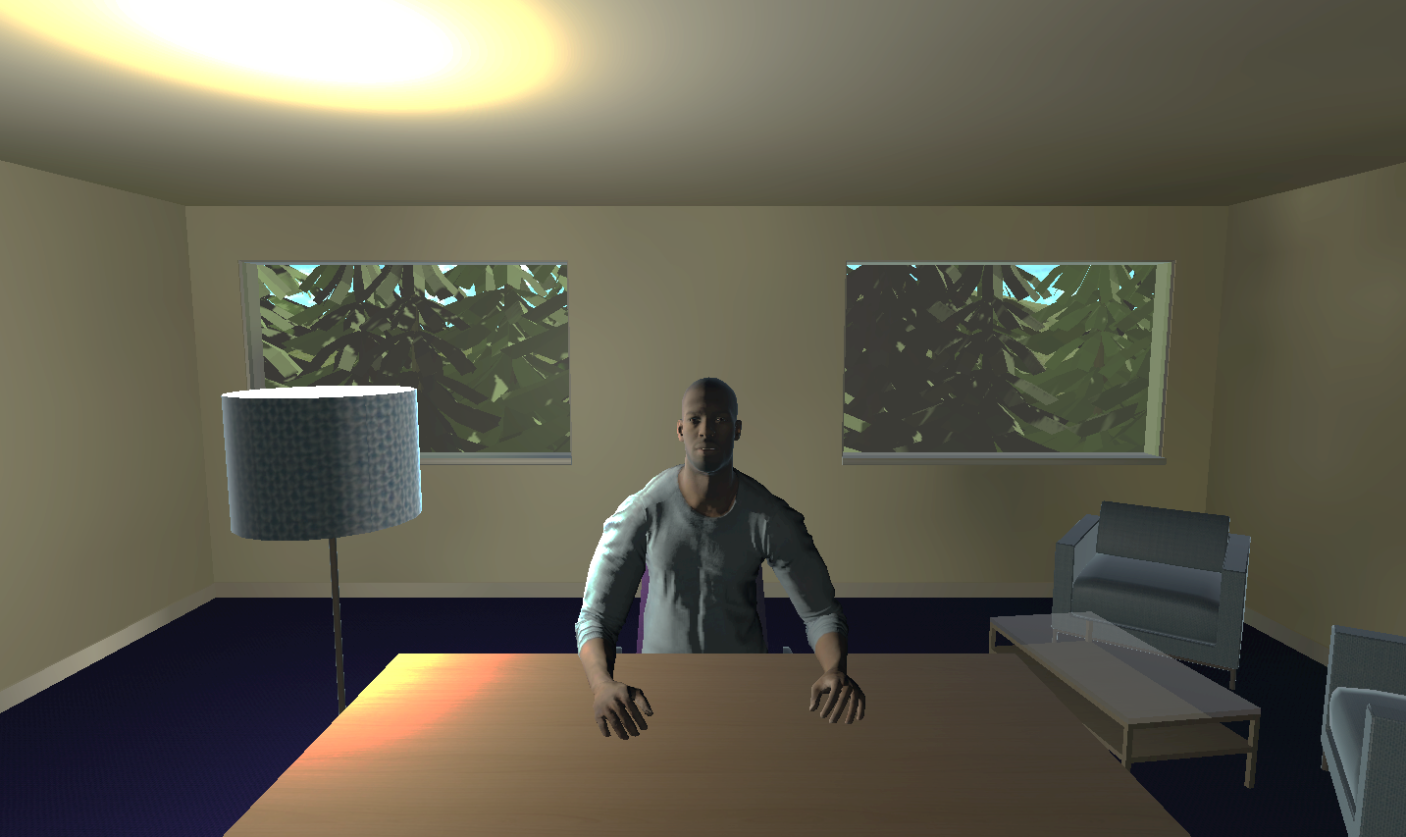
Outside of the Project Work:
Similarities To My Project:
VR project
Using the LSL protocol (to send markers)
Uses the EEGO amplifier for EEG data collection
What I Can Do With It:
Once implemented, I will be able to test my system within this project
Notes:
(07:30) - > (08:30)
Though the work I’m doing outside of dissertation is not directly related to my project, it will allow me to have an opportunity to test the system I create within a different environment.
The work involves using the Unity 3D game engine to run a experiment trial, the user is asked to perform a task and then report how they felt about it.
This links to my project since all actions done by the participant are sent over the LSL protocol to the recording device as markers, these can then be used to mark the data. Similar to what I may be needing to do if I require my own data collection for training.

Slide 10
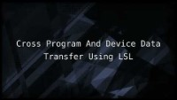
https://youtu.be/cc_U5H57LCg
Notes:
(08:30) - > (10:00)

Slide 11

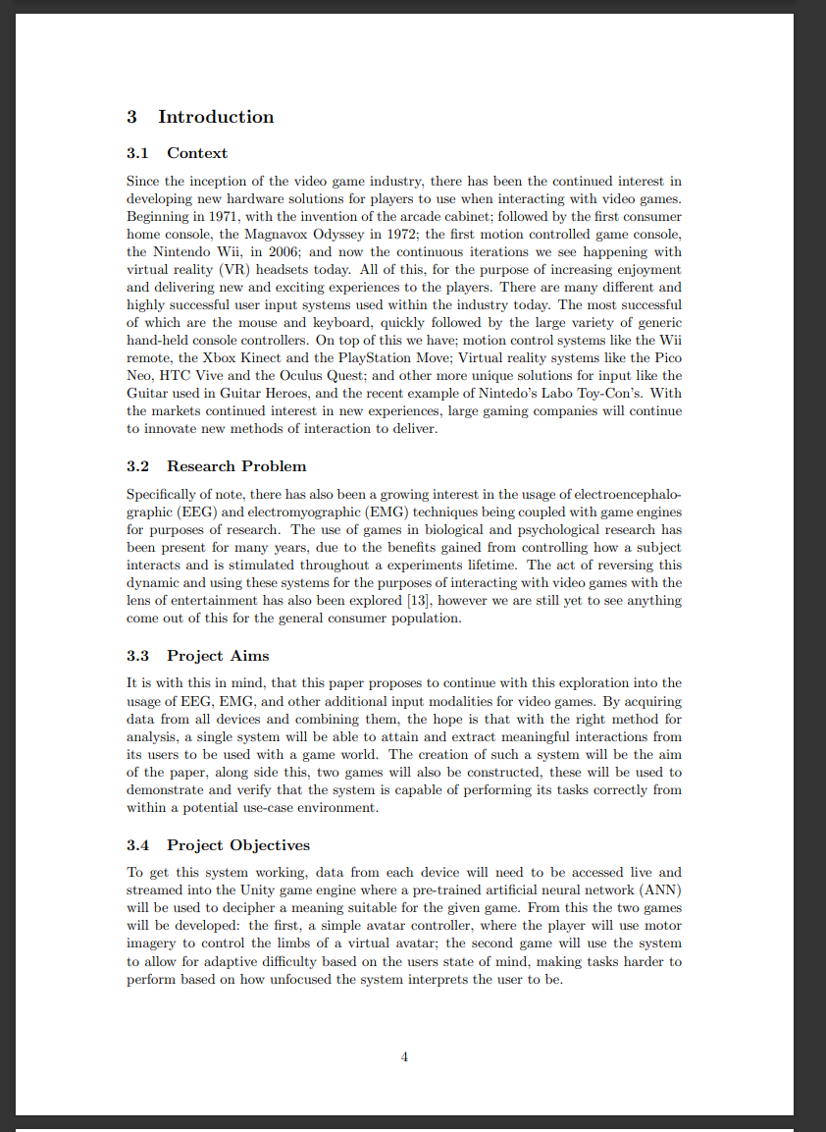
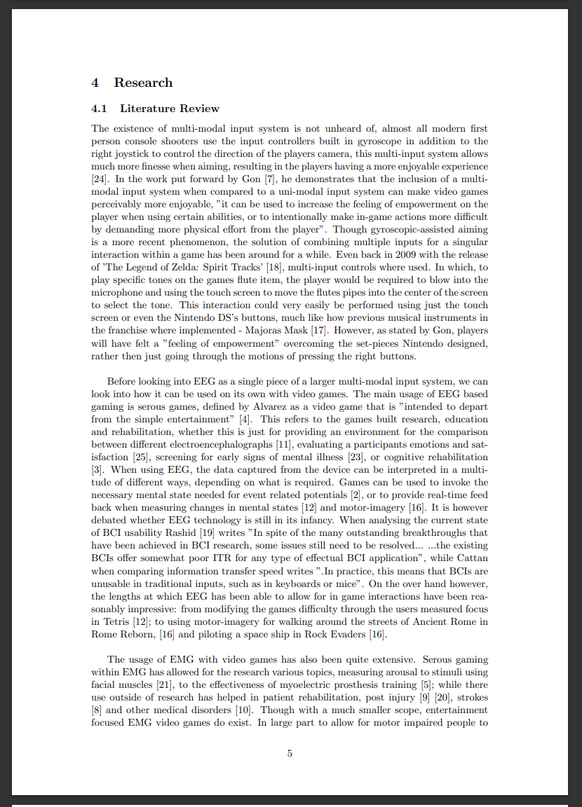
The Dissertation Progress:
- Drafted Layout
- Introduction
Context
Research Problem
Project Aims
Project Objectives
- Lit Review
Current examples of multi-modal input systems
Uni-modal EEG systems in gaming
Uni-modal EMG systems in gaming
EEG / EMG based multi modal input systems
Roughly 2000 words - ( ¼ Complete Draft )
Notes:
(10:00) - > (11:00)
The contents page, reference page and the first 2 chapters of the dissertation are complete (though only in draft form)
These two section cover just under 2000 words. Each section has been split into the format show above.

Slide 12
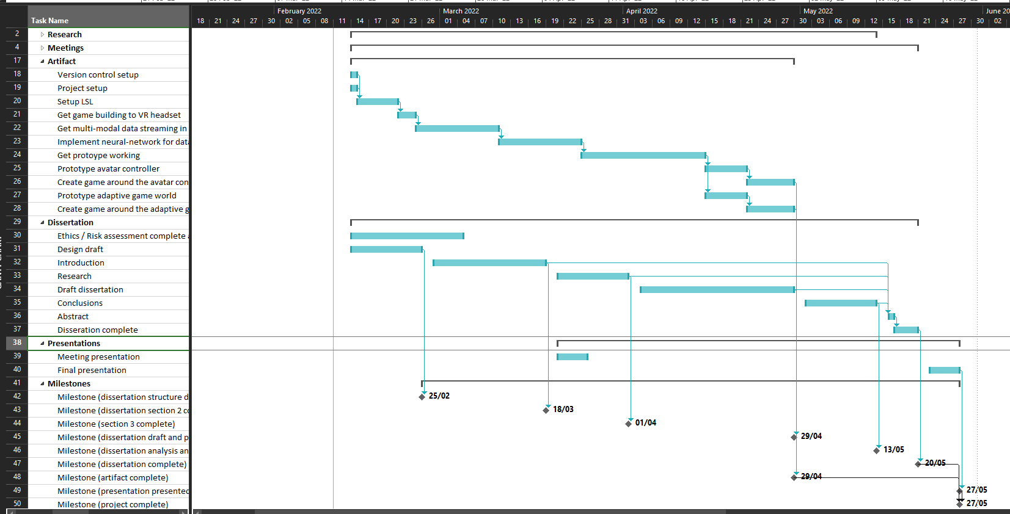
Where I Am:
Today
Notes:
(11:00) - > (12:00)
This is my full Gantt chart with today labelled.

Slide 13
Where I Am:
Project Plan:
Artifact
Setup Version Control
Setup Unity Project
Get LSL working across devices
​Implement Neural Network for data analysis
Setup Tensorflow online analysis through Unity
​Design and train a network using offline EEG / EMG data
Dissertation
Ethics / Risk assessment hand in.
Dissertation Draft
Introduction – (draft)
Literature Review – (draft)
Today
Notes:
(12:00) - > (13:00)
So far I am reasonably on track with what I set out to do at the start of the project, having only one part of the project – being the implementation of the offline ANN classifier for motor imagery not working – however this I am already in the process of working on.
The deadline for this is the end of this week, though I might not be able to get this done by said deadline it shouldn’t take me much longer hopefully.

Slide 14
Future Plans:
Next Two weeks:
Artifact
Get a working offline analysis model for EEG motor-imagery classification.
( 25th March )
Then get this working in real time with Unity, though this will still be feeding in offline data.
( 25th March )
Do the same for the Emteq system, EMG data.
( 31st March – if possible)
Dissertation
Polish drafted sections and continue the literature review.
( 31st March )
Start methodology
( 4th April )
Notes:
(13:00) - > (14:00)
Over the next few weeks I plan on starting the implementation of the offline EEG classifier, once this is complete I may be able to then look into combining other data along side it to see if the multi-modal input system can be created. (potentially look into eye tracking and check how much stress from eye movement for difficulty paradigm)
After which I will also need to finish up the first 2 chapters to a state I am reasonably happy with (not to say I wont change them in the future but they do need work)
Once all of this is done, there is still larger aspects of the project that will need to be looked into, this will be the creation of the system fully, the creation of the two games and finally writing the rest of the report.

Slide 15
Future Plans:
Next Two weeks:
Artifact
Get a working offline analysis model for EEG motor-imagery classification.
( 25th March )
Then get this working in real time with Unity, though this will still be feeding in offline data.
( 25th March )
Do the same for the Emteq system, EMG data.
( 31st March – if possible)
Dissertation
Polish drafted sections and continue the literature review.
( 31st March )
Start methodology
( 4th April )
Later:
Artifact
Modify the neural networks to support the analysis of all modalities instead of just them separately.
( 8th April )
Train this to accomplish specific tasks, such as moving avatar skeleton bones, or influencing the difficulty of a simple game.
( 12th April )
Polish multi-modal analysis system.
( 23rd April )
Get two demonstration games built to demo the system.
( 30th April )
Dissertation
Finish methodology
( 30th April)
Write conclusion
( 12th May )
Polish dissertation for submission
( 18th May)
Notes:
(14:00) - > (15:00)
Over the next few weeks I plan on starting the implementation of the offline EEG classifier, once this is complete I may be able to then look into combining other data along side it to see if the multi-modal input system can be created. (potentially look into eye tracking and check how much stress from eye movement for difficulty paradigm)
After which I will also need to finish up the first 2 chapters to a state I am reasonably happy with (not to say I wont change them in the future but they do need work)
Once all of this is done, there is still larger aspects of the project that will need to be looked into, this will be the creation of the system fully, the creation of the two games and finally writing the rest of the report.

Slide 16
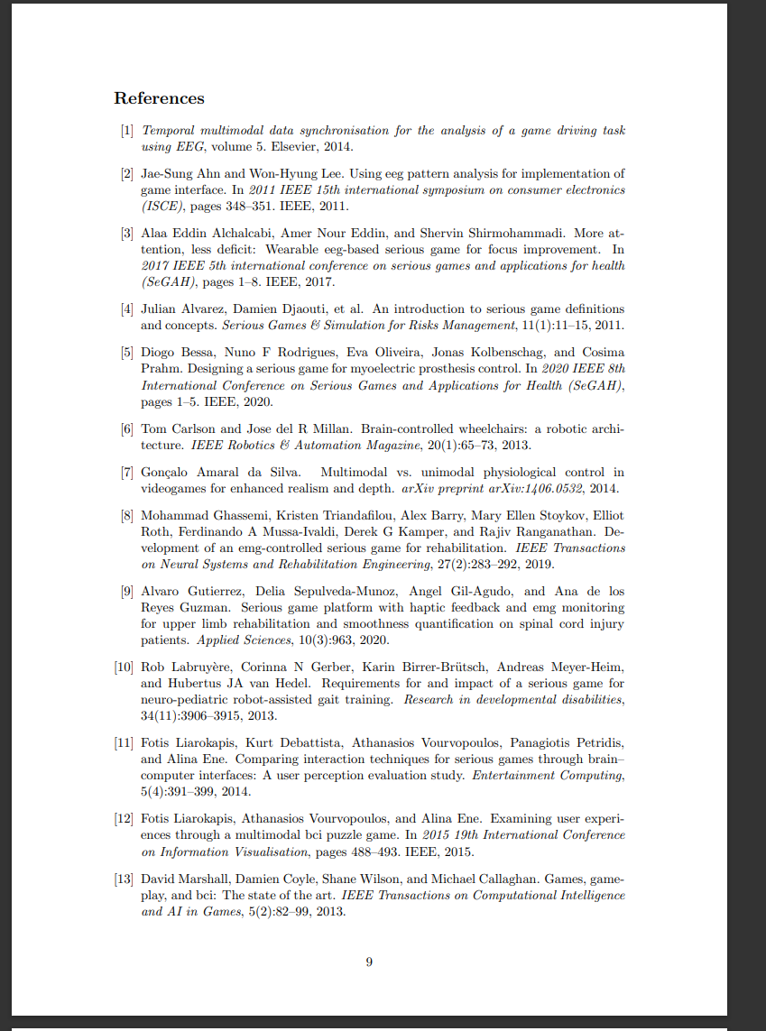
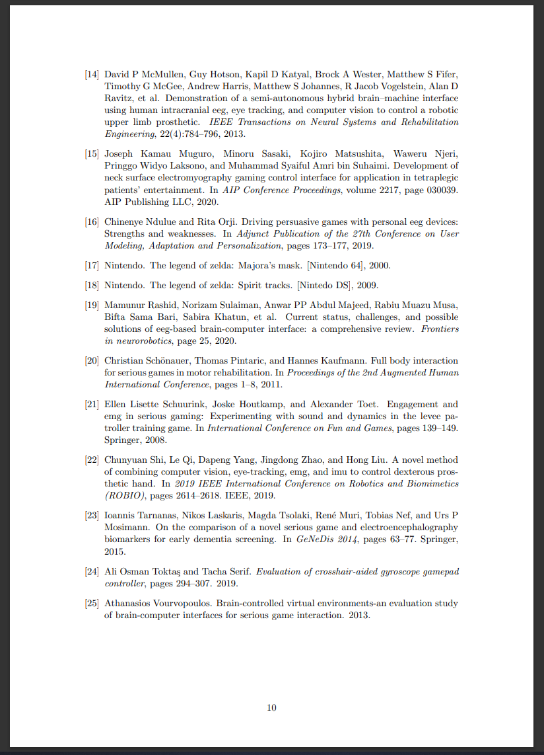
References:
Papers Used in Presentation
( Carlson, 2013 )
( McMullen, 2013 )
( Haris, 2021 )
Notes:
(00:00) - > (01:00)

